Slide 1
COS 781 (Data Mining)
Theme 9
Ant-Based Data Mining

Slide 2
Overview
Ant colony optimisation
Rule induction for classification
AntMiner
Data clustering using ants

Slide 3
Ant Colony Optimisation
Population-based
Individuals are referred to as ants
Ants base their decisions on stigmergy
Ants deposit pheromone as they move
Movement affected by pheromone concentration
Ants tend to follow paths with more pheromone
Still a reduced chance of taking a lower concentration path
Pheromone evaporates over time
What does this result in?

Slide 4
Ant Colony Optimisation
Requirements
A heuristic function
Measures quality of solution parts
A pheromone update rule
Updates pheromone concentrations
Based on ant movement
Usually incorporates a forgetting factor
A probabilistic transition rule
Based on heuristic function and pheromone
Often based on graph representations
But not always

Slide 5
Rule Induction for Classification
Recall rule induction
Requires a pre-classified data set
Produces a rule representation of a data set
Decision tree
Induction rules (ordered or unordered)
Rules can be used to
Describe the overall data set characteristics
Classify unseen data examples

Slide 6
AntMiner: Overview
AntMiner
Developed by Parpinelli, Lopes, and Freitas
Produces an ordered production rule set
Conditions are conjunctions of conditions
Includes a default rule
Only supports discrete attributes
What if you have continuous attributes?
Three level design

Slide 7
AntMiner: The Algorithm
Top-level procedure finds one rule set
trainingSet = {all training cases}
ruleList = [ ]
while |trainingSet| is still larger than a threshold do
Initialise pheromone (equally distributed)
Use ants to find a good classification rule
Add best rule found by all ants to ruleList
Remove trainingSet examples covered by best rule
end while
Add a default rule to ruleList
Mid-level
procedure

Slide 8
AntMiner: The Algorithm
Mid-level procedure finds one rule
repeat
Create new ant with an empty rule
Add one condition at a time to the rule
Prune rule
Increase pheromone on ant’s trail, based on rule quality
until (maximum number of ants exceeded) or
(no improvement over last k iterations)
Bottom-level
procedure
Happens when the last k ants all produce the
same rule (i.e. a convergence test)

Slide 9
AntMiner: The Algorithm
Bottom-level adds conditions and class
repeat
Add condition on an unused attribute to the antecedent
Rule classification is majority class of covered examples
until no more conditions can be added to the rule
Based on a
probability for
each condition
No more conditions can be added to the rule if either:
Any added condition will cover fewer cases than a minimum threshold
All attributes have already been added to the ant’s rule

Slide 10
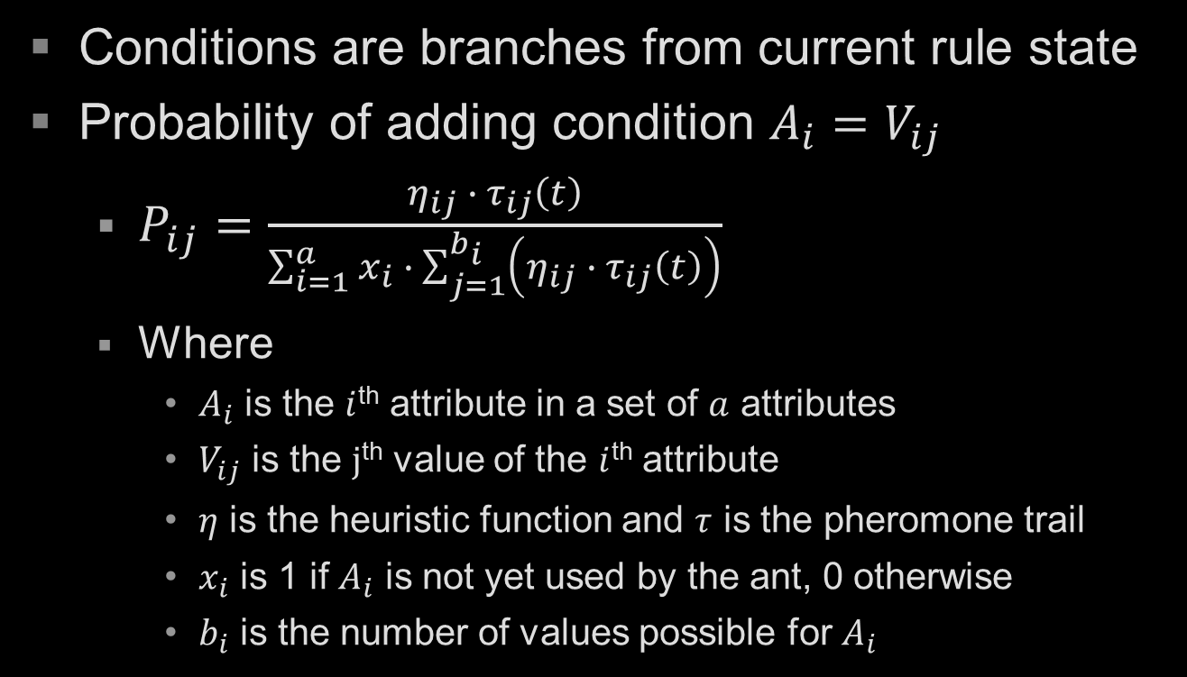
AntMiner: Adding Conditions
Conditions are branches from current rule state
Probability of adding condition $A_{i}=V_{ij}$
$P_{ij}=\frac{η_{ij} ∙ τ_{ij}\left(t\right)}{\sum_{i=1}^{a}{x_{i}} ∙ \sum_{j=1}^{b_{i}}{\left(η_{ij} ∙ τ_{ij}\left(t\right)\right)}}$
Where
$A_{i}$ is the $i$^{th} attribute in a set of $a$ attributes
$V_{ij}$ is the $j$^{th} value of the $i$^{th} attribute
$η$ is the heuristic function and $τ$ is the pheromone trail
$x_{i}$ is 1 if $A_{i}$ is not yet used by the ant, 0 otherwise
$b_{i}$ is the number of values possible for $A_{i}$

Slide 11
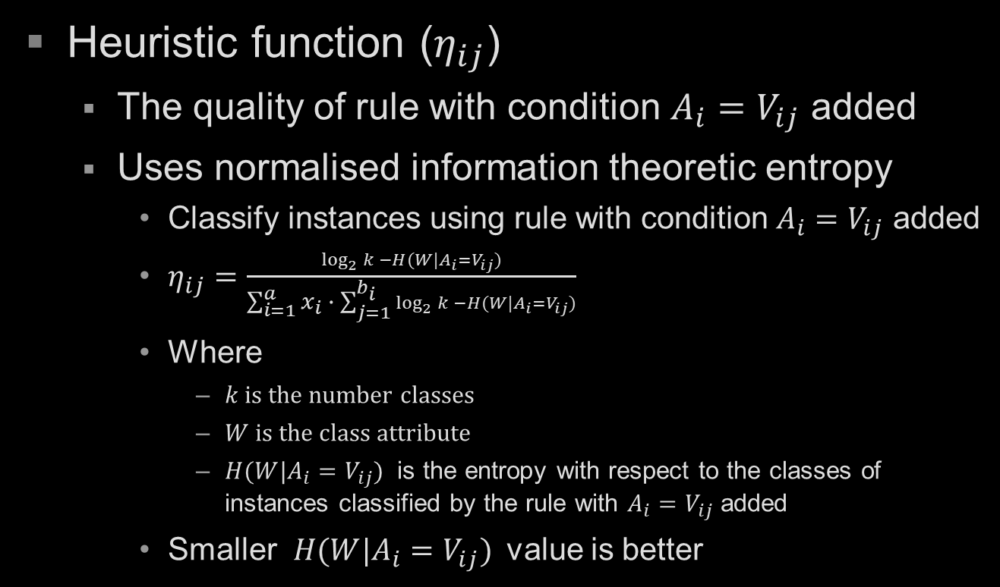
AntMiner: Heuristic Function
Heuristic function ($η_{ij}$)
The quality of rule with condition $A_{i}=V_{ij}$ added
Uses normalised information theoretic entropy
Classify instances using rule with condition $A_{i}=V_{ij}$ added
$η_{ij}=\frac{\log_{2}{k} −H(W|A_{i}=V_{ij})}{\sum_{i=1}^{a}{x_{i}} ∙ \sum_{j=1}^{b_{i}}{\log_{2}{k} −H(W|A_{i}=V_{ij})}}$
Where
$k$ is the number classes
$W$ is the class attribute
$H(W|A_{i}=V_{ij})$ is the entropy with respect to the classes of instances classified by the rule with $A_{i}=V_{ij}$ added
Smaller $H(W|A_{i}=V_{ij})$value is better

Slide 12
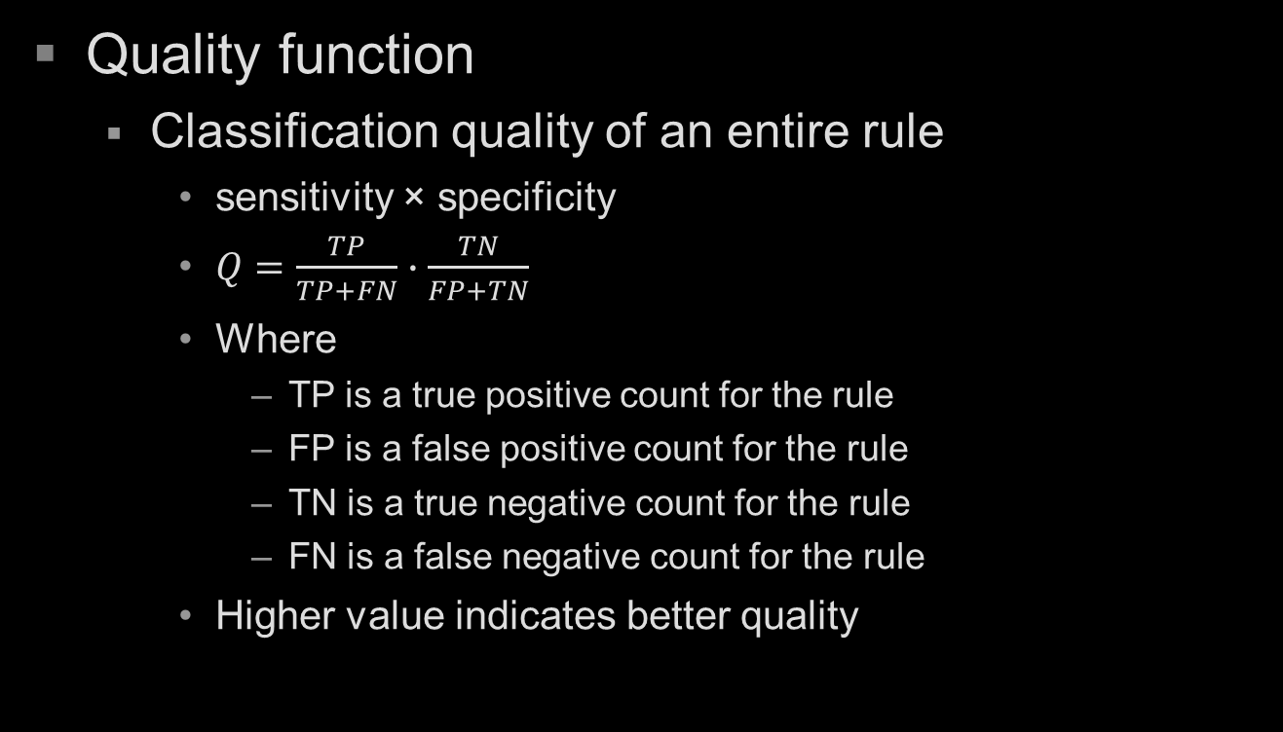
AntMiner: Rule Quality
Quality function
Classification quality of an entire rule
sensitivity × specificity
$Q=\frac{TP}{TP+FN}∙\frac{TN}{FP+TN}$
Where
TP is a true positive count for the rule
FP is a false positive count for the rule
TN is a true negative count for the rule
FN is a false negative count for the rule
Higher value indicates better quality

Slide 13
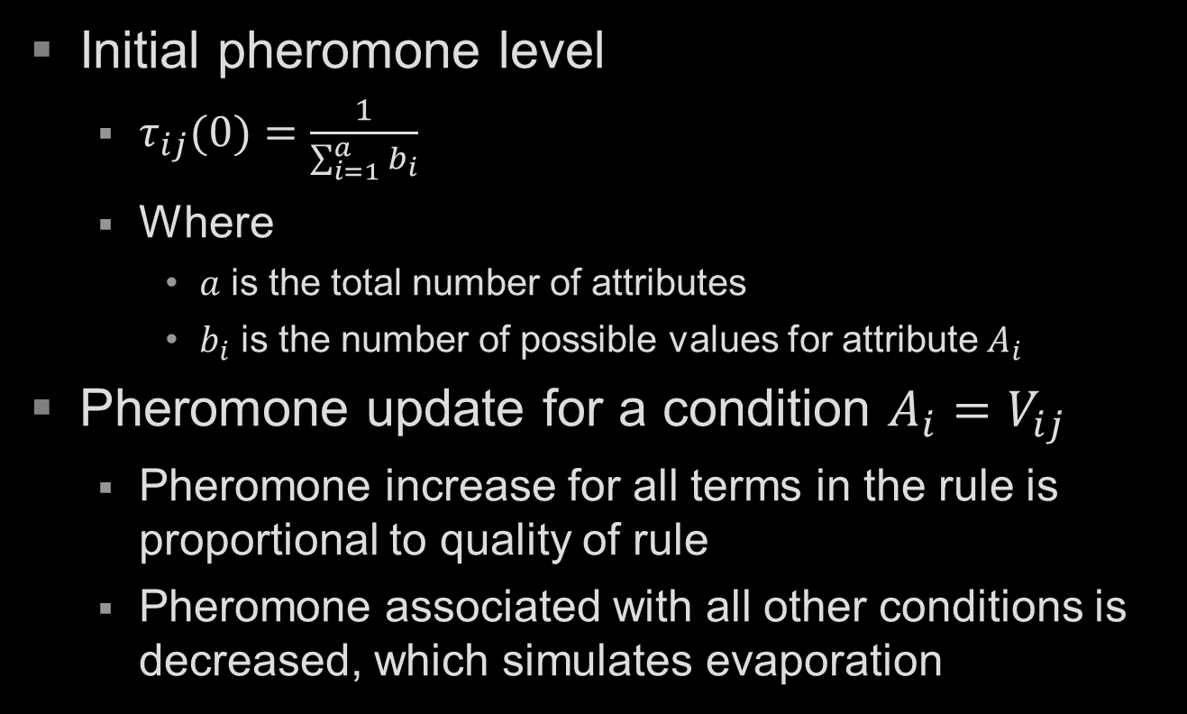
AntMiner: Pheromone Update
Initial pheromone level
$τ_{ij}(0)=\frac{1}{\sum_{i=1}^{a}{b_{i}}}$
Where
$a$ is the total number of attributes
$b_{i}$ is the number of possible values for attribute $A_{i}$
Pheromone update for a condition $A_{i}=V_{ij}$
Pheromone increase for all terms in the rule is proportional to quality of rule
Pheromone associated with all other conditions is decreased, which simulates evaporation

Slide 14
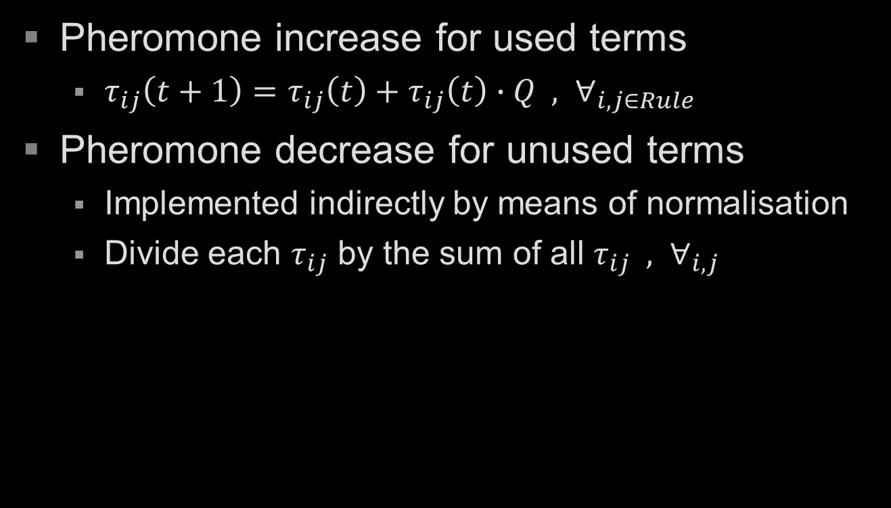
AntMiner: Pheromone Update
Pheromone increase for used terms
$τ_{ij}\left(t+1\right)=τ_{ij}\left(t\right)+τ_{ij}\left(t\right)∙Q , ∀_{i,j∈Rule}$
Pheromone decrease for unused terms
Implemented indirectly by means of normalisation
Divide each $τ_{ij}$ by the sum of all $τ_{ij} , ∀_{i,j}$

Slide 15
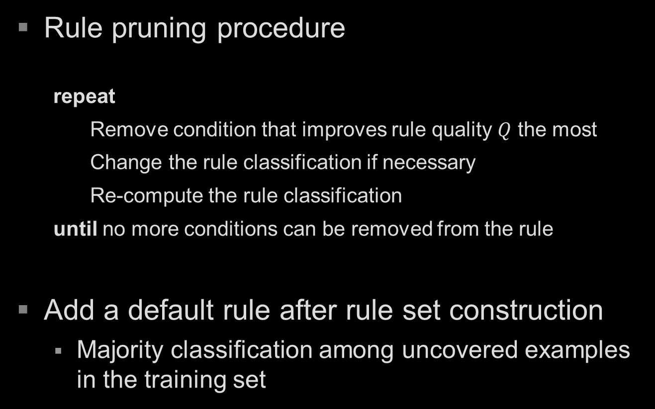
AntMiner: Rule Pruning
Rule pruning procedure
repeat
Remove condition that improves rule quality $Q$ the most
Change the rule classification if necessary
Re-compute the rule classification
until no more conditions can be removed from the rule
Add a default rule after rule set construction
Majority classification among uncovered examples in the training set
Because the
majority class
for rule may
change

Slide 16
AntMiner vs Decision Trees
In comparison to decision tree building
AntMiner deals with attribute interactions better
Why do you think this is the case?

Slide 17
Data Clustering using Ants
Ants perform organisation tasks
Group similar things together
Food
Dead ants
Eggs, larvae, and pupae
Still not well understood
Feedback mechanism
Probability that ant will pick up/drop something

Slide 18
Data Clustering using Ants
Basic idea
Ants in a population wander around
Unladen ants pick up items
Based on a probability measure
More likely to pick up in low concentration areas
Laden ants drop items
Based on a probability measure
More likely to drop in high concentration areas

